Slide 1

Forecasting wind power and turbine energy efficiency
Michos K. Dimitrios – PhD dissertation
ENERGY METEOROLOGY
Nadia Kairaktidi
1068622

Slide 2
1. Brief description of CFD modeling
Computational Fluid Dynamics (CFD) uses numerical simulations to analyze complex fluid flows where analytical solutions aren’t possible and to complement experimental and theoretical approaches. It solves governing equations for variables like velocity, pressure, and temperature at discrete points.
CFD is faster, safer, and more cost-effective than experiments and allows study of complex phenomena that are difficult to measure or analyze otherwise. This flexibility fosters innovation despite hardware limits and finds applications in diverse fields like aerospace, marine, chemical processing, meteorology, hydrology, medicine, and sports.
Although CFD has advanced greatly, developing fast, accurate, and robust methods is ongoing. Reduced computational costs are enabling CFD to surpass statistical methods for real-time applications, such as ultra-short-term forecasting requiring integration of thermal, airflow, and optical data to capture system complexity.
Besides fluid mechanics, numerical analysis and computer science are essential for conducting fluid flow simulations. Furthermore, verification and validation are also critical steps to ensure the reliability of the simulation results.

Slide 3
General Steps in CFD Numerical Simulations :
Select Governing Equations: Choose the appropriate flow physics model -> full Navier-Stokes, or simplified equations plus turbulence and non-Newtonian models if needed.
Discretization: Conversion of the governing equations into algebraic form using methods like finite difference, finite volume, or finite element, and selection of a suitable grid for spatial discretization.
Numerical Solution & Visualization: Solving of the algebraic equations with numerical algorithms and visualization of the results using graphs, animations, or other tools.

Slide 4
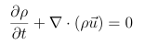
2. Governing Equations of Fluid Flows
2.1 Conservation Laws
Our understanding of fluid dynamics relies on the fundamental conservation laws: mass, momentum, and energy cannot be created or destroyed, only transformed or transferred. These laws form the governing equations that describe fluid behaviour and underpin both theoretical and numerical analysis.
1. Conservation of Mass (Continuity Equation)
This law stems from the fundamental principle that matter cannot be created or destroyed. In the context of fluid flow, it implies that the mass within a control volume (CV) can only change due to the net flow of mass across its boundaries. Mathematically, this is represented by the continuity equation.
This equation states that the rate of change of density at a point plus the divergence of the mass flux ρu at that point must be zero.

Slide 5
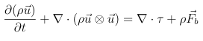
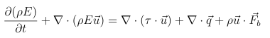
2. Conservation of Momentum (Newton’s Second Law)
This law states that the rate of change of momentum of a body is equal to the net force acting on it. In fluid flows, momentum can change due to both external forces (like gravity or pressure gradients) and internal forces (arising from viscous stresses within the fluid).
This law derives from the first law of thermodynamics, which states that energy is conserved in an isolated system. In fluid flows, energy can be transported by the fluid’s motion (kinetic energy), stored within the fluid (internal energy), and transferred as heat or work.
3. Conservation of Energy (First Law of Thermodynamics)
The left side of the equation represents the rate of change of momentum of the fluid parcel, while the right side represents the sum viscous forces, where τ represents the momentum exchange due to the stress at the surface of the CV, and body forces acting on it.
The left side of the equation represents the rate of change of energy of the fluid parcel, while the right side represents the net rate of heat addition, the work done by viscous and body forces.

Slide 6
2.2 Divergence and Gradient Forms
Both divergence and gradient forms mathematically describe the same physical phenomena in fluid dynamics. The choice between them depends on the numerical method and it can affect accuracy and stability.
Divergence form is commonly used in the Finite Volume Method (FVM) because it aligns with conservation principles, ensuring mass, momentum, and energy are conserved at the discrete level by discretizing fluxes across control volume faces.
Gradient form is typically used in the Finite Difference Method (FDM), where derivatives are computed directly at grid points, which can simplify boundary condition implementation.
The Finite Element Method (FEM) can use both forms and is especially useful for complex geometries. For example, in simulating wind over terrain, divergence form helps maintain mass balance, while gradient form captures sharp changes in flow. This dual approach enhances accuracy and provides insights into how terrain features influence flow dynamics.
On the next slides, the conservation laws in both forms are presented.

Slide 7
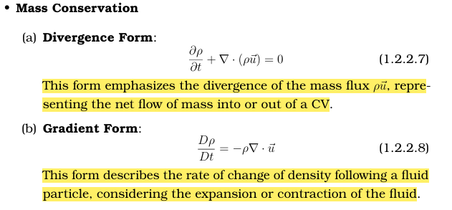

Slide 8
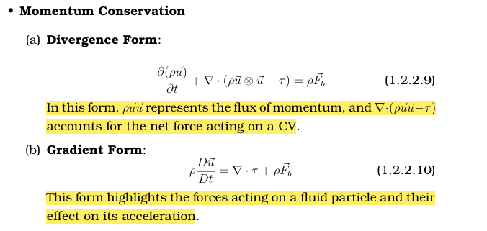

Slide 9
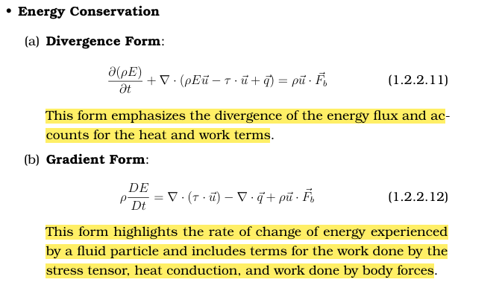

Slide 10
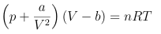
3. Modeling different flow types
The Navier-Stokes equations, which govern the conservation equations, are complex and nonlinear, with analytical solutions only possible for simple geometries and fully developed flows. Therefore, numerical methods are commonly used. Simplifications reduce computational effort and are applied to different flow types. Complex phenomena like turbulence and multiphase flows often require semi-empirical models, which introduce errors that must be managed.
For gases like air, treated as ideal under many conditions, the equation of state connects temperature, volume, and pressure. Understanding whether a fluid is compressible or incompressible helps select the right model:
Compressible flows: Density varies significantly with pressure and temperature, typical for high-speed gases or large pressure changes. The Ideal Gas Law is commonly used, with more accurate models like the Van der Waals equation applied under extreme conditions:
where a,b are Van der Waals constants.
Incompressible flows: Density remains nearly constant despite pressure changes, simplifying analysis. This applies mainly to liquids and low-speed gases. Pressure variation under gravity is described by:

Slide 11
Boundary Layer Approximation
The boundary layer approximation is a significant simplification of the Navier-Stokes equations, applied to flows where one direction is dominant and the geometry changes gradually. This scenario is common in flows through channels, over flat plates, or around mildly curved surfaces. The approximation is based on the following key assumptions:
Negligible Diffusive Transport: Momentum diffusion (viscous effects) along the main flow direction is much smaller than convection, so viscous forces there can be ignored compared to inertial forces.
Dominant Velocity Component: The velocity along the primary flow direction is much larger than perpendicular components, meaning flow behavior is mainly influenced by changes in this direction.
Small Pressure Gradient Normal to Flow: Pressure variation perpendicular to the main flow is minimal and can be considered negligible compared to variations along the flow direction.
With these assumptions, the boundary layer equations - simplified forms of the Navier-Stokes equations - can be derived. They focus on the dominant flow direction while accounting for viscosity normal to the flow. In complex terrains, the strict assumptions of boundary layer theory may not fully hold. However, the approximation can still be applied in specific regions or sub-areas where conditions are suitable, offering useful insights and simplifying simulations.

Slide 12
3.2 Flows and Partial Differential Equations
Understanding airflow is essential in wind energy, especially around wind turbines, over complex terrain, and within wind farms (WFs). These flows are described by partial differential equations (PDEs), which model how velocity, pressure, and temperature change over space and time. Classifying PDEs helps predict fluid behaviour and improve designs. They are grouped into three types based on how information propagates:
Elliptic
Parabolic
Hyperbolic
Each type represents different physical phenomena and requires specific solution methods. This understanding is key for optimizing wind turbine performance and other engineering applications.

Slide 13
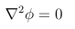
Elliptic Equations
Elliptic equations describe steady-state flows - situations where air properties don't change over time. This is especially useful in wind energy, where assuming steady flow simplifies the analysis of wind turbines and wind farms (WFs).
For example, airflow around a turbine blade can be modeled using the Laplace equation:
where ϕ is the velocity potential.
This helps predict smooth, stable flow around blades, ensuring efficient turbine operation.
In WFs, elliptic equations help analyze how turbines interact, guiding optimal placement to minimize wake effects and maximize energy output.
They are also useful in modeling steady wind over complex terrain, such as hills, where airflow follows land contours which is important for effective turbine siting.
Beyond wind energy, elliptic PDEs apply in electrostatics (electric potential) and heat conduction (steady-state temperature distribution).

Slide 14
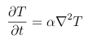
Parabolic Equations
Parabolic equations describe processes that evolve over time and are influenced by earlier conditions. They’re ideal for flows with a dominant direction and gradual changes - like wind moving over complex terrain.
An example is the heat equation:
where T is the temperature and α is the thermal diffusivity.
In WFs, parabolic equations model how the boundary layer interacts with the ground and turbines. This is essential for predicting how turbulence grows and affects downstream turbines, helping improve turbine layout and efficiency.
They also apply to wind turbine blades, where the boundary layer thickens along the surface, impacting drag and energy capture. The boundary layer approximation, a simplified parabolic form of the Navier-Stokes equations, helps optimize blade design.
Beyond wind energy, parabolic PDEs are used in heat conduction and groundwater flow, modeling how temperature or water spreads over time.

Slide 15
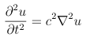
Hyperbolic Equations
Hyperbolic equations are used to model wave propagation and sudden changes in flow. In wind energy, they capture events like shock waves, gust fronts, and rapid airflow disturbances.
In complex terrain, these equations help simulate how wind interacts with abrupt features like cliffs or ridges, creating turbulence and rapid shifts in pressure and velocity.
For example, when a gust hits a turbine, the surrounding airflow changes quickly. Hyperbolic PDEs, such as the wave equation, help predict the turbine’s response:
where u is the wave field and c is the wave speed.
This is key for designing turbines that can handle sudden wind changes.
Beyond wind energy, hyperbolic PDEs model sound, seismic, and electromagnetic waves, crucial in fields like acoustics and earthquake engineering.

Slide 16
In real-world wind flow simulations, multiple PDE types often coexist. For example, in a wind farm over complex terrain:
Parabolic behaviour appears near surfaces (e.g., ground, turbine blades) due to viscous effects.
Elliptic behaviour emerges in regions where the flow is more steady and uniform.
Hyperbolic behaviour arises during sudden wind changes like gusts or turbulence.
This mix of behaviours means no single PDE type can capture the full complexity of the flow. Engineers must combine elliptic, parabolic, and hyperbolic models to design and operate wind farms effectively.
For instance, mountainous regions may show:
Elliptic flow in sheltered valleys,
Parabolic boundary layers on windward slopes,
Hyperbolic effects at ridges or passes with sudden wind shifts.
Such mixed flows are also critical in environmental applications, like modeling pollutant dispersion under varying terrain and weather.

Slide 17
4. Coordinate and Basis Vector Systems
4.1 Coordinate Systems
Different coordinate systems are used in fluid simulations depending on geometry:
Cartesian (x, y, z): Best for simple, rectangular domains. Easy to implement due to uniform grids.
Cylindrical (r, θ, z): Suitable for flows with rotational symmetry, like in pipes or around cylinders.
Spherical (r, θ, ϕ): Ideal for radial symmetry, such as flow around spheres, though equations are more complex.
Curvilinear (orthogonal/non-orthogonal): Used for irregular geometries. Orthogonal systems simplify math while non-orthogonal ones offer more flexibility for complex shapes.

Slide 18
4.2 Basis Vector Systems
Once a coordinate system is selected, the next decision involves how to represent vectors and tensors:
Fixed vs. Variable Basis:
Fixed basis (e.g., Cartesian): Basis vectors don’t change across space.
Variable basis (e.g., curvilinear): Basis vectors vary from point to point, impacting how derivatives are calculated.
Covariant vs. Contravariant Components: These terms refer to the way vector components transform under a change of coordinates.
Covariant: Components change with the basis.
Contravariant: Components change oppositely to the basis. This distinction is essential in curved geometries to ensure correct transformation of physical quantities.
Physical vs. Non-Physical Components:
Physical: Correspond directly to measurable directions (e.g., velocity in x-direction).
Non-Physical: More abstract, often tied to the coordinate system’s structure rather than physical directions.

Slide 19
4.3 Implications for Numerical Methods
The choice of coordinate system and basis plays a crucial role in numerical simulations of fluid dynamics. It directly impacts:
Discretization Methods & Grid Types:
Cartesian grids are simple and computationally efficient, making them ideal for regular, box-shaped domains.
Curvilinear grids adapt better to irregular geometries, improving accuracy but increasing computational complexity.
Impact on Governing Equations:
The selected system and basis affect the mathematical form of the equations. For example, switching from a fixed Cartesian basis to a variable curvilinear one introduces additional geometric terms that must be accounted for in the simulation.
Practical Considerations:
The decision depends on geometry, boundary conditions, and desired accuracy.
More complex problems (e.g., flow over terrain or around curved surfaces) often require curvilinear or even non-orthogonal systems.
In summary, selecting the appropriate coordinate system and basis is a foundational step. It determines how accurately and efficiently the physical problem can be translated into a numerical model.

Slide 20
5. Discretization Methods
5.1 Finite Difference Method (FDM)
The FDM is the most conceptually straightforward and historically earliest numerical technique for solving PDEs in CFD. Its core principle is the approximation of derivatives using the values at neighbouring grid points and Taylor series expansions, applied over a structured grid that divides the computational domain.
Advantages :
Simplicity: Ideal for beginners due to its intuitive formulation.
Efficiency: Well-suited for problems with regular, simple geometries, as structured grids simplify the implementation of boundary conditions and numerical solvers.
Extensive Literature: Well-documented, with rich educational resources.
Limitations :
Geometric Flexibility: Poorly suited to complex geometries with curved or irregular boundaries, due to its reliance on structured grids.
Accuracy Dependence: Accuracy depends heavily on grid resolution and the order of the Taylor expansion. Higher-order schemes improve accuracy but increase computational cost.
Boundary Accuracy: Less effective in regions near boundaries or with strong gradients.
Non-Conservative Formulation: Unlike finite volume methods, FDM is not inherently conservative. Ensuring conservation of mass, momentum, or energy requires careful formulation.

Slide 21
5.2 Finite Volume Method (FVM)
The Finite Volume Method (FVM) is based on the integral form of conservation laws. It divides the computational domain into non-overlapping control volumes, applying the conservation equations to each volume in an integral sense. This integral approach inherently ensures conservation of mass, momentum, and energy, making FVM particularly suitable for flows involving shocks, discontinuities, or complex physics.
Advantages :
Conservation: Exact conservation properties at the discrete level, crucial for accurately capturing shocks and discontinuities.
Geometric Flexibility: Supports unstructured grids with arbitrary shapes (e.g., triangles, tetrahedra), enabling simulation of complex geometries encountered in real-world engineering problems.
Robustness: Applicable to a wide range of flow regimes, from low-speed incompressible to high-speed compressible flows with shocks.
Limitations :
Complex Implementation: More complex to implement than FDM, especially on unstructured grids.
High-Order Accuracy: Achieving high-order schemes is challenging, particularly near boundaries or steep gradients.
Boundary Conditions: Implementing boundary conditions can be difficult for complex geometries and specific scenarios like non-reflecting boundaries in wave propagation.

Slide 22
5.3 Finite Element Method (FEM)
The Finite Element Method (FEM) is based on the weak or variational formulation of the governing PDEs. It divides the computational domain into a mesh of finite elements and approximates the solution within each element using piecewise polynomials or other suitable basis functions.
Advantages :
Complex Geometry Handling: Supports unstructured meshes with diverse element shapes and sizes, enabling accurate representation of complex domains.
Mesh Adaptation: Allows for mesh refinement and adaptation to capture localized flow features effectively.
Higher-Order Approximations: Naturally facilitates high-order accuracy through the use of higher-degree polynomial basis functions, often requiring fewer elements for the same accuracy.
Multiphysics Flexibility: Easily handles coupled problems involving multiple physical phenomena and varied PDEs.
Limitations :
Computational Cost: Can be computationally intensive, especially for large 3D problems and higher-order elements.
Implementation Complexity: Requires a deep understanding of weak formulations, basis functions, and numerical integration, making it more complex than FDM or FVM.
Conservation Properties: While FEM can be made conservative, ensuring strict conservation (important in shocks or discontinuities) requires careful formulation.

Slide 23
6. Numerical Grids
Numerical grids are a fundamental component of Computational Fluid Dynamics (CFD) simulations, providing a discrete representation of the continuous physical domain. They allow the numerical calculation of flow variables across the domain.
Key Factors:
Grid Resolution:
Refers to the element size and distribution.
Finer grids improve accuracy but increase computational cost.
Grid Structure:
Structured grids: Aligned, regular arrangement; computationally efficient but limited flexibility.
Unstructured grids: Irregular arrangement; more flexible for complex geometries but computationally heavier.
Grid Quality:
Depends on element shape, aspect ratio, and distortion.
Poor quality elements can lead to numerical instability, convergence problems, or divergence.
Well-designed numerical grids are critical for achieving accurate, efficient, and stable CFD simulations. Grid design should align with the complexity of the geometry, the desired solution accuracy, and available computational resources.

Slide 24
6.1 Key Factors Influencing Grid Choice
The choice of a numerical grid is crucial in CFD simulations, directly impacting accuracy, efficiency, and feasibility and several factors influence this decision:
1. Geometric Complexity
Simple Geometries : Best handled with structured grids for their simplicity and efficiency.
Complex Geometries : Require unstructured grids for flexibility and detail.
Hybrid Grids: Combine both to leverage advantages where appropriate.
2. Flow Features
Localized phenomena : Benefit from adaptive/dynamic grids that refine resolution in critical regions.
3. Computational Resources
Finer grids improve accuracy but are more computationally expensive.
Unstructured and adaptive meshes demand more memory and processing power.
Large-scale simulations require careful balance between resolution and computational limits, often using parallelization.
4. Numerical Method Compatibility
Finite Difference Method (FDM): Suited for structured grids due to regular spacing.
Finite Volume Method (FVM): Works on both structured and unstructured grids.
Finite Element Method (FEM): Excels on unstructured grids, especially for complex geometries.
The grid choice must be tailored to the geometry, flow features, available resources, and the numerical method. An optimal grid ensures both accuracy and computational efficiency in CFD simulations.

Slide 25
6.2 Classification of Numerical Grids
Topology
Cartesian Grids
Cartesian grids are characterized by their alignment with the Cartesian coordinate axes. This orthogonal arrangement leads to a mesh composed of rectangular or cuboidal elements. Their regular and predictable structure makes them exceptionally simple to implement, highly efficient computationally.
Advantages
Straightforward implementation and computational efficiency
Well-suited for simple geometries with rectangular or box-shaped domains
Easy to visualize and interpret results.
Limitations
Difficulty in accurately representing complex or curved boundaries.
Stair-stepping effect near curved surfaces, leading to potential inaccuracies.
Inefficient for highly irregular geometries, requiring excessive refinement in some regions.
In wind turbine simulations, they are often suitable for modeling the far-field flow, where the domain is large and relatively uniform. However, near the turbine blades, alternative grid types like body-fitted structured grids or unstructured meshes are preferred to capture the detailed aerodynamic behaviour around the blade surfaces.

Slide 26
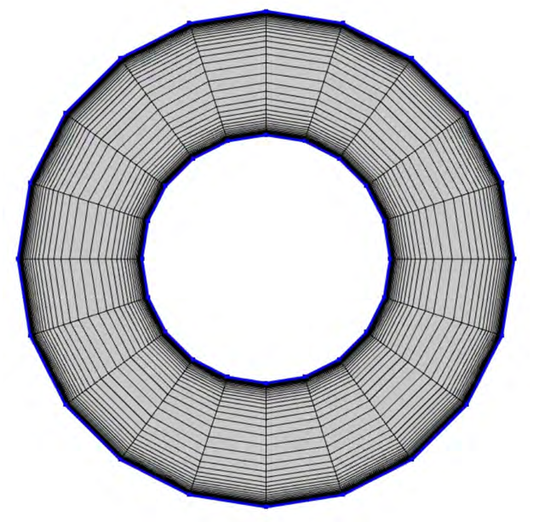
Curvilinear Grids
Curvilinear grids allow grid lines to curve and conform to the domain’s geometry and boundary shapes. This ability enhances the geometric flexibility and accuracy of numerical simulations.
Advantages
Better representation of complex geometries and curved boundaries.
Reduced grid skewness and distortion near curved surfaces, leading to improved accuracy.
Can be more computationally efficient than unstructured grids for certain geometries.
Limitations
More challenging to generate than Cartesian grids.
May still exhibit some skewness or distortion in regions of high curvature.
Not as flexible as unstructured grids for handling highly irregular geometries.

Slide 27
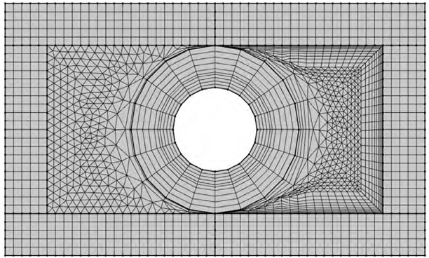
Body-fitted Grids
Body-fitted grids take the concept of curvilinear grids a step further by aligning the grid lines directly with the boundaries of the object being simulated. This ensures excellent accuracy in capturing flow features near the object’s surface.
Advantages
Superior accuracy for complex geometries, especially near boundaries
Minimal grid skewness and distortion, leading to improved numerical stability
Ideal for simulations where accurate boundary layer resolution is critical.
Limitations
Can be challenging and time-consuming to generate, particularly for highly irregular shapes
May require specialized grid generation techniques and software
Not as flexible as unstructured grids for handling moving boundaries or evolving geometries.

Slide 28
B. Structure
The structure of a numerical grid refers to the arrangement and connectivity of grid points, which fundamentally differentiates structured from unstructured grid systems. Each approach offers distinct advantages and limitations, influencing the suitability of a grid for specific types of CFD problems.
Structured Grids
Structured grids are defined by their regular and orderly configuration of grid points. This layout is typically logically indexed, allowing for predictable connectivity and straightforward neighbour relationships.
Advantages
Efficient Data Handling: The regular grid topology allows for simple, index-based access to grid points and associated variables, which improves memory efficiency and enables optimized data traversal during computation.
Simplified Numerical Implementation: Many numerical schemes are naturally aligned with structured grids due to their reliance on consistent spacing and connectivity, enabling simpler code structures and faster solver performance.
Excellent for Simple Geometries: Ideally suited for domains with regular, simple geometries, such as:
Rectangular channels
Straight ducts
Annular or axisymmetric regions
In such cases, grid lines can be directly aligned with coordinate directions, making it easier to apply boundary conditions and analyze solution behaviour.

Slide 29
Challenges
Limited Geometric Flexibility: The rigidity of structured grids can make it difficult to conform to complex or highly irregular geometries. To capture such geometries accurately, grid generation may require:
Excessive refinement in localized regions, increasing computational cost
The introduction of grid distortion or skewness, potentially degrading numerical accuracy and stability
Examples and Variants
Cartesian Grids: The most basic form of structured grids, ideal for domains with rectilinear boundaries. Their simplicity makes them highly efficient for problems involving box-shaped geometries or far-field regions.
Cylindrical Grids: In cases involving cylindrical or axisymmetric domains, cylindrical coordinate systems can be used to generate structured grids aligned along radial, azimuthal, and axial directions. These are effective for simulating internal flows in pipes or rotational machinery.
Body-Fitted Structured Grids: For moderately complex domains, body-fitted structured grids may be used. These grids curve to match the geometry of solid boundaries, improving accuracy without entirely abandoning structured connectivity. However, care must be taken to minimize element skewness, particularly in highly curved regions.
Structured grids are a powerful tool in CFD when applied to domains that match their topological and geometric assumptions. However, as the complexity of the geometry increases, the benefits of structured grids must be carefully weighed against the limitations they impose.

Slide 30
Unstructured Grids
Unstructured grids embrace irregularity in the arrangement of grid points. This flexibility empowers them to handle complex geometries and adapt to evolving flow features with remarkable ease.
Advantages
Geometric Flexibility: Unstructured grids conform to intricate shapes and boundaries, making them ideal for simulations involving complex geometries. This makes them a preferred choice in fields such as aerospace, automotive, and environmental engineering.
Adaptability to Flow Features: Unstructured grids can be refined or coarsened in targeted regions to resolve localized phenomena. This adaptability enhances resolution where it matters most, while keeping the grid coarse in less critical regions to reduce computational cost.
Handling Moving Boundaries: The flexible structure of unstructured grids enables dynamic adjustment of the grid when dealing with moving interfaces or deformable domains which are typical in fluid-structure interactions, sloshing, or free surface flows.
Challenges
Complex Data Structures: Because grid point connectivity is irregular, unstructured grids require specialized data structures for efficient storage and access. This often results in more complex code and increased memory usage compared to structured grids.
Computational Overhead: The lack of regularity can lead to higher computational costs. Despite this, ongoing improvements in mesh generation tools, parallel computing, and numerical algorithms have significantly mitigated these issues.

Slide 31
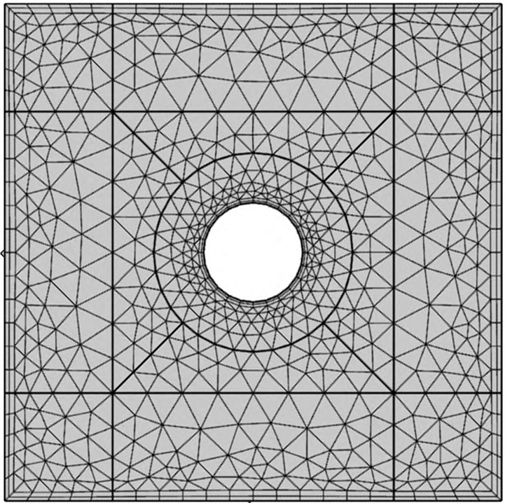
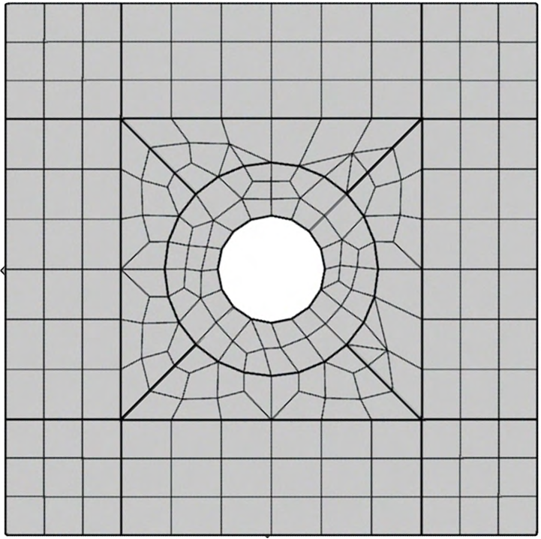
Examples of Unstructured Grids
Triangular Grids (2D): Composed of triangular elements, these grids provide excellent flexibility for representing irregular 2D geometries. They are commonly used in CFD simulations related to aerodynamics, hydrodynamics, and heat transfer.
Tetrahedral Grids (3D): These are the 3D analogs of triangular grids and are often used for modeling complex three-dimensional domains. Their flexibility allows for detailed modeling of geometries such as engine components, turbine blades, or natural terrains.
Hybrid Grids: A combination of different element types. These grids aim to balance geometric flexibility with numerical efficiency.

Slide 32
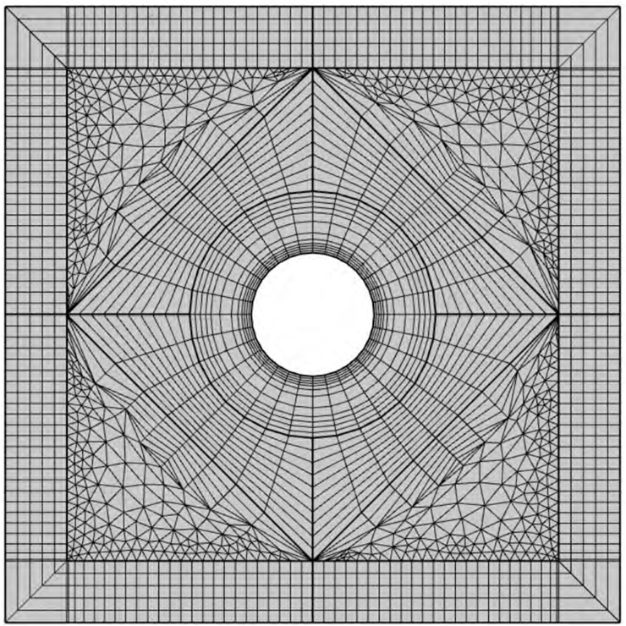
Unstructured grids are a powerful asset in CFD when dealing with complex physical domains, localized flow dynamics, and time-varying boundaries, though they require more sophisticated tools and computational resources to leverage their full potential.
In summary, the choice between structured and unstructured grids hinges on a careful balance between geometric complexity, flow features, computational resources, and numerical method compatibility. Structured grids are favoured for their simplicity and efficiency in handling simple geometries, while unstructured grids excel in representing complex shapes and adapting to evolving flow phenomena. The optimal grid choice ultimately depends on the specific requirements and constraints of the CFD simulation at hand.
Example of a hybrid grid.

Slide 33
C. Adaptability
The adaptability of a numerical grid refers to its ability to modify its configuration during the simulation to better resolve critical flow features or accommodate changes in domain geometry. This dynamic behaviour offers substantial benefits in accuracy and computational efficiency, though it also introduces greater complexity in implementation and numerical procedures.
Static Grids
Static grids maintain a fixed configuration throughout the simulation. Grid points and element connectivity remain unchanged, regardless of how the flow evolves or how the domain geometry may change.
Advantages:
Simple to implement and manage.
Predictable and consistent computational cost.
Well-suited for stationary boundaries and uniform flow fields.
Limitations:
Cannot adapt to capture localized phenomena (e.g., shocks, boundary layers).
May require excessive global refinement to ensure adequate resolution, leading to higher computational cost in less critical regions.
Not suitable for problems involving moving boundaries or deforming domains.
Example:
In steady-state simulations of flow around a wind turbine in a uniform wind field, a static grid might be sufficient if the objective is to capture the overall flow pattern and wake. However, if the goal is to resolve detailed vortices near blade tips or turbulent structures in the wake, a dynamic or adaptive grid would be more appropriate.

Slide 34
Adaptive Grids
Adaptive grids have the ability to dynamically modify their configuration during the simulation, refining the mesh in regions of high gradients or flow complexity, and coarsening it in smoother regions. This adaptability provides several distinct advantages:
Advantages:
By concentrating grid points in critical regions, adaptive grids can greatly improve resolution of flow features, leading to higher accuracy and better capture of fine-scale details.
Adaptive grids optimize computational resources by allocating elements where they are most needed, reducing computational time and memory usage.
They are particularly effective for capturing localized flow phenomena, such as shocks, boundary layers and turbulent structures, dynamically refining the mesh near these areas to ensure accurate tracking over time.
Limitations:
More complex to implement and requires sophisticated numerical solution procedures.
Depends on robust error estimation and adaptation criteria to determine when and where to refine or coarsen the mesh.
May introduce additional computational overhead due to ongoing mesh adjustments during the simulation.
Example:
In atmospheric flow simulations over complex terrain, adaptive grids can refine the mesh around mountain peaks, valleys and other topographic features where flow gradients are steep and turbulence is significant. This enhances the resolution of complex interactions between the flow and the terrain.

Slide 35
Dynamic Grids
Dynamic grids take adaptability further by allowing grid points to move or deform to track moving boundaries or interfaces within the flow domain. This capability is crucial for simulations involving:
Applications:
Fluid-Structure Interaction : In FSI scenarios, dynamic grids adapt to deforming structures, maintaining accurate representation of the fluid-structure interface and the surrounding flow field.
Free Surface Flows: These involve interfaces between immiscible fluids. Dynamic grids can track moving surfaces, capturing phenomena like waves, splashes, and other interfacial dynamics.
Moving Objects: Used in simulations involving moving components. The grid adapts by deforming or remeshing to follow the object’s motion and accurately represent the flow around it.
Limitations:
High complexity compared to static or adaptive grids.
Requires specialized algorithms for mesh movement and deformation.
Introduces additional challenges for numerical stability and conservation properties.
Example:
In wind turbine simulations under turbulent atmospheric conditions, dynamic grids can be used to capture interactions between rotating blades and unsteady wind fields.
Summary:
Static grids: Best for simple, steady-state problems.
Adaptive grids: Ideal for resolving localized flow phenomena with optimized computational effort.
Dynamic grids: Essential for handling moving boundaries, deforming geometries, and fluid-structure interactions, though they demand more computational and algorithmic complexity.

Slide 36
6.3 Specialized Grid Types
In addition to the fundamental classifications based on structure, topology, and adaptability, several specialized grid types have been developed to address specific challenges and enhance the flexibility and accuracy of CFD simulations. These grids often combine elements from different categories or introduce innovative techniques for mesh generation and adaptation
Overset Grids (Chimera Grids)
Overset grids, also known as Chimera grids, use a multi-grid approach in which multiple structured or unstructured grids overlap to cover the computational domain.
Advantages:
Handling Complex Geometries: Overset grids are excellent for modeling complex configurations involving multiple components or moving objects. Each component can be meshed using its own grid, adapted specifically to its shape. These component grids can overlap and interact without the need for conformal meshing.
Efficient Grid Generation: Rather than generating a single, high-quality grid for a complex domain, overset methods allow you to use simpler, component-specific grids. This simplifies mesh generation and can reduce preprocessing time.
Simulating Moving Objects: Ideal for simulations involving relative motion, such as rotorcraft, store separation, or turbomachinery. Each moving part can be modeled on its own grid, which can translate or rotate independently while maintaining overall solution accuracy.

Slide 37
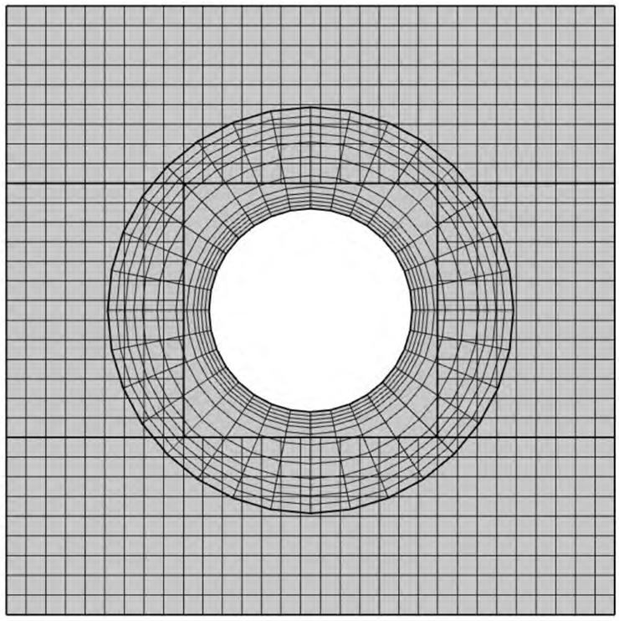
Challenges:
Interpolation at Overlaps: Accurate, conservative interpolation of flow variables between overlapping regions is critical. Poor interpolation can lead to numerical errors or loss of conservation.
Computational Overhead: Managing multiple overlapping grids and performing real-time interpolation can lead to higher computational costs compared to single-grid methods.
Complex Data Structures: Overset grids require advanced data structures to manage grid connectivity, overlapping regions, and inter-grid communication.
Example Application:
In wind turbine simulations over complex terrain, an overset grid approach can be particularly effective. A body-fitted grid may be used to mesh the turbine blades and tower, while a coarser background grid handles the surrounding terrain. These grids overlap in the turbine’s vicinity, allowing for:
Detailed resolution of the flow near the turbine
Computational efficiency in the far field

Slide 38
Hierarchical Grids
Hierarchical grids use multiple levels of refinement to efficiently capture multi-scale flow phenomena. The approach involves applying coarser grids in areas with relatively uniform flow, while finer grids are reserved for regions exhibiting high gradients, complex structures, or where greater accuracy is essential.
Advantages:
Efficient resolution of multi-scale phenomena by focusing computational effort where it's needed most.
Reduction in computational cost compared to using a uniformly fine grid across the entire domain.
Adaptability to evolving flow features, making it suitable for transient and non-uniform flow problems.
Challenges:
Requires robust refinement criteria to determine where and when to apply grid resolution changes.
Load balancing and data management become more complex, especially in parallel computing environments.
Inter-grid communication and interface handling may require specialized numerical algorithms to maintain consistency and accuracy.
Example Application:
In simulations of atmospheric boundary layer flows, a hierarchical grid can be applied to efficiently represent the domain. A coarse grid may model the upper atmosphere, where the flow is more uniform, while progressively finer grids are used closer to the ground surface to capture turbulence, shear layers, and terrain interactions more accurately.

Slide 39
Block-Structured Grids
Block-structured grids partition the computational domain into multiple blocks, each discretized using a structured grid. This hybrid approach combines the flexibility of unstructured grids with the computational efficiency of structured grids.
Advantages:
Flexibility in grid refinement: Different blocks can have varying levels of refinement, enabling efficient allocation of grid points in regions of interest.
Effective handling of complex geometries: Dividing the domain into blocks allows simpler structured grids to be used within each block, even in complex domains.
Compatibility with existing tools: This approach benefits from structured grid generation tools and numerical methods, which are well-established and efficient.
Challenges:
Interface treatment: Ensuring conservation and solution continuity across block boundaries requires careful implementation.
Data management and parallelization: The need to manage multiple blocks introduces additional complexity, particularly for large-scale simulations.

Slide 40
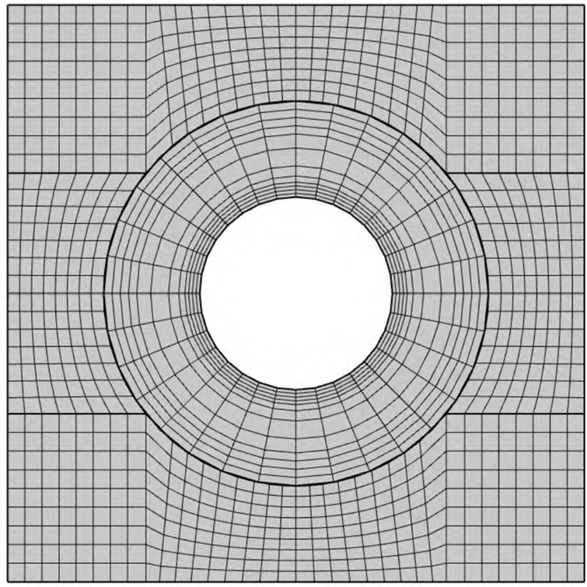
Types of Block Interfaces:
Matching Interfaces: Occur when adjacent blocks share boundaries with perfectly aligned grid points. These are easier to implement and ensure smooth communication between blocks.
Non-Matching Interfaces: Arise when grid points do not align at block boundaries. These require specialized interpolation schemes or conservative treatments to maintain accuracy and avoid numerical artifacts.
Example Application:
In simulations involving aircraft aerodynamics, block-structured grids are often used to discretize the flow domain. Individual blocks may be fitted to the wings, and engine nacelles, with each block maintaining a structured layout while collectively modeling the full geometry with high fidelity.

Slide 41
Composite or Chimera Grids
Composite grids, are a specialized form of block-structured grids where blocks are allowed to overlap. This technique enables the combination of multiple structured grids to effectively simulate complex flow fields, especially those involving moving bodies or intricate static geometries.
Key Features:
Overlapping Structured Grids: Each structured block can overlap with others, allowing localized refinement and easier grid generation for complex geometries.
Domain Decomposition: Complex domains can be decomposed into simpler subdomains, each discretized with its own structured grid.
Flexibility for Moving Bodies: Εffective in simulations involving relative motion between components.
Advantages:
Grid Reusability: Individual component grids can be reused and moved independently.
Simplified Meshing of Complex Assemblies: Αvoid generating a single, highly complicated grid.
Adaptability: Effective for both static and dynamic applications, depending on how the overlapping regions are managed.
Challenges:
Conservation at Interfaces: Enforcing conservation laws across overlapping regions is non-trivial and requires careful numerical treatment.
Interpolation Complexity: Accurate interpolation between overlapping grids is necessary to maintain solution fidelity and stability.
Increased Implementation Complexity: Managing multiple overlapping grids requires specialized data structures and solver algorithms.

Slide 42
Distinction from Overset Grids:
While "Chimera grids" and "Overset grids" are often used interchangeably, the context of application might vary:
Overset grids emphasize moving grids relative to each other, such as rotating blades within a fixed domain.
Composite Chimera grids may emphasize handling complex static geometries through structured domain decomposition.
In essence, both fall under the same overarching methodology of using overlapping grids to increase flexibility, mesh quality, and efficiency in complex CFD simulations.
Summary
Selecting the appropriate grid type is crucial for accurate and efficient CFD simulations:
Structured grids offer high efficiency for simple domains.
Unstructured grids provide flexibility for complex geometries.
Block-structured and Chimera grids combine strengths from both structured and unstructured approaches.
Adaptive and dynamic grids enhance resolution where and when needed, improving accuracy for evolving flows or moving boundaries.
Understanding these classifications allows CFD practitioners to strike the right balance between accuracy, efficiency, and computational feasibility depending on the simulation requirements.

Slide 43
7. Properties of Numerical Methods
The success and reliability of any numerical method in CFD stems from a set of fundamental properties that dictate its behaviour and performance. These properties are essential for ensuring that numerical methods produce accurate, stable, and physically meaningful solutions for fluid flow problems.
7.1 Conservation
The governing equations in CFD are derived from fundamental physical conservation laws. A conservative numerical method ensures that these laws are preserved when transferred to the discrete level of computation.
Why Conservation Matters:
Ensures the numerical solution adheres to physical principles.
Leads to realistic and meaningful results.
Helps maintain numerical robustness in long-time simulations.
Key Aspects:
Global Conservation: Ensures the total quantity across the entire domain remains constant over time.
Local Conservation: Ensures that each control volume or finite element individually satisfies conservation laws, which is generally more stringent and preferred in CFD.
Role of Discretization Methods:
Finite Volume Method (FVM): Naturally conservative due to its integral formulation over control volumes. Widely used in CFD because it directly enforces conservation at the local level.
Finite Difference Method (FDM) and Finite Element Method (FEM): Require additional formulation or adjustments to ensure conservation, as they are based on differential or weak forms of the governing equations.

Slide 44
7.2 Boundedness and Realizability
Boundedness
Boundedness ensures that the numerical solution remains within physically meaningful limits. This prevents unrealistic or unbounded values that could compromise the simulation’s integrity or lead to numerical instabilities.
Example: In incompressible flows, density should remain constant, and velocity components must stay within physically realistic ranges.
Importance: Prevents spurious results and maintains simulation stability.
Techniques to Maintain Boundedness:
Use of flux limiters or slope limiters to control numerical oscillations.
Careful boundary condition implementation.
Selecting appropriate numerical schemes.

Slide 45
Realizability
While boundedness focuses on numerical limits, realizability enforces a broader set of physical constraints to ensure the solution remains consistent with the laws of physics.
What It Enforces:
Positivity of density, pressure, and temperature.
Adherence to the second law of thermodynamics.
Positivity of turbulent kinetic energy and dissipation rates.
Satisfaction of inequality constraints (e.g., Schwarz inequality for shear stresses).
Significance:
Prevents non-physical artifacts like negative pressures or unbounded turbulence.
Ensures solutions are not just numerically correct but physically plausible.
Techniques to Enforce Realizability:
Use of flux/slope limiters and artificial viscosity.
Careful design of numerical schemes and turbulence models.
Selection of realizability-compliant turbulence models, such as the Realizable k-ε model, which:
Modifies turbulent viscosity formulation.
Ensures positivity of normal stresses.
Satisfies the Schwarz inequality.

Slide 46
7.3 Consistency
Consistency is a fundamental property of any numerical method. It ensures that as the discretization parameters approach zero, the discretized equations converge to the original partial differential equations (PDEs) governing the fluid flow.
Key idea: The numerical solution asymptotically approaches the exact solution as the discretization is infinitely refined.
Mathematical basis: Consistency requires careful discretization of the PDEs so that truncation errors from approximating derivatives and integrals vanish as the discretization parameters tend to zero.
Significance: A consistent method guarantees that the numerical solution properly represents the underlying physical phenomena in the limit of infinite resolution.
Consistency alone is not sufficient for a satisfactory solution; stability and convergence are also critical properties.

Slide 47
7.4 Stability
Stability is a critical property that prevents errors introduced at any stage of the computation from amplifying uncontrollably as the solution progresses.
Key idea: A stable numerical method ensures that small perturbations or numerical errors do not grow exponentially, avoiding divergent or non-physical solutions.
Error control: Stability keeps numerical errors bounded so they do not overwhelm the true solution, preserving simulation integrity.
Numerical schemes: The choice of schemes for approximating derivatives and integrals heavily influences stability.
Implicit vs. explicit: Implicit schemes, which solve systems of equations at each time step, are generally more stable than explicit schemes, which update solutions directly from previous values.
Time step restrictions: Explicit methods often require limits on the time step size to maintain stability.
Example criterion: The Courant-Friedrichs-Lewy (CFL) condition is a well-known stability condition that restricts the time step based on the grid size and wave speeds.

Slide 48
7.5 Convergence and Accuracy
Convergence is a fundamental aspect of any numerical method. It signifies that the numerical solution approaches the exact solution as the discretization is refined, either by reducing grid spacing or the time step.
A convergent method ensures the computed solution reliably approximates the true solution.
In iterative procedures, convergence means successive approximations approach a fixed point or solution, and convergence criteria determine when iterations are sufficiently close.
Convergence is closely related to accuracy:
As discretization is refined, finer details of the flow field are captured, improving accuracy.
Accuracy measures how closely the numerical solution approximates the exact solution.
Higher-order methods, which use more sophisticated approximations, generally provide better accuracy than lower-order methods.
The order of accuracy characterizes how quickly the error decreases as discretization is refined; higher-order methods converge faster.
However, higher-order methods often require more computational resources and memory.
The choice of accuracy depends on the problem’s requirements and desired solution fidelity.

Slide 49
7.6 Efficiency
Efficiency in computational fluid dynamics refers to the computational resources required to obtain a numerical solution. An efficient method balances accuracy and computational cost, delivering solutions within reasonable timeframes and manageable resource usage.
Several factors influence the efficiency of a numerical method:
Algorithms and Data Structures: Well-optimized algorithms and efficient data handling significantly improve performance.
Parallel Computing: Large-scale CFD simulations can benefit from parallelization, distributing the computational workload across multiple processors or cores.
Hardware Choice: The type of hardware impacts speed and scalability.
Trade-Offs and Pareto Optimization
Efficiency is inherently tied to trade-offs between: Accuracy + Computational time + Memory consumption
These objectives often conflict, making it impossible to optimize all simultaneously. In such scenarios, Pareto optimization becomes essential
A Pareto front represents the set of non-dominated solutions meaning those for which no metric can be improved without degrading another.
For example:
One solution may offer high accuracy but require more computational time. Another may provide faster results at the cost of some accuracy. We must choose a solution along the Pareto front that best aligns with our specific project goals.

Slide 50
Practical Implications
In CFD simulations:
Understanding and managing Pareto trade-offs is essential to achieving efficient and accurate solutions.
The choice depends on whether high precision or fast turnaround is more critical for the application.
In wind energy simulations, for example, these decisions impact the reliability and usability of the results.
In this PhD work, the steady-state form of the conservation equations is used to approximate transient solutions which are typically parabolic in nature. This reduces computational time significantly. However, it's important to recognize that:
Abrupt changes in wind speed and direction can introduce approximation errors.
Possible remedies include:
Combining transient and steady-state formulations in hybrid approaches.
Refining temporal or spatial resolution in steady-state models.
These decisions reflect deliberate positioning on the Pareto front, balancing efficiency and accuracy according to the simulation's objectives.

Slide 51


